Slide 1
Data Analysis Report
Predicting Driver Fault in Traffic Collisions Using Machine Learning
Praneet Peshkar – (UID – 121004284)
Satyam Rai – (UID – 121298461)
Shyam Solanke (UID – 121127761)

Slide 2
Abstract
The aim of this project is to develop a classification model to assess driver fault in traffic incidents, using a dataset from the Montgomery Police Department that includes information on location, vehicle specifications, driving behavior, and environmental conditions. By analyzing variables such as collision type, lighting, and driver impairment, we seek to identify patterns and significant predictors of fault. The insights from this analysis could help us take preventive measures and even help make laws aimed at reducing traffic incidents.

Slide 3
Initial Observations
The following conditions increases the likelihood of the driver being held responsible for accidents:

Slide 4
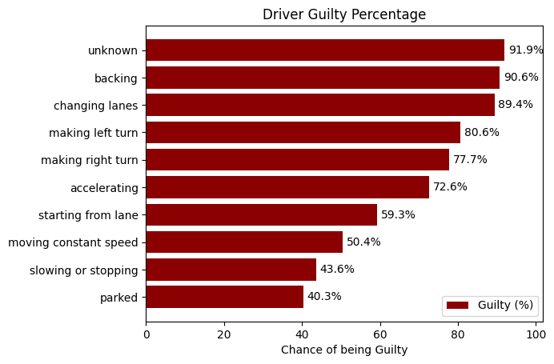
Performing any of the following maneuvers just before the accident—reversing, changing lanes, making a U-turn, turning right on red, starting from a parked position, leaving a traffic lane, or making a left turn—they are held responsible in 80% of cases

Slide 5
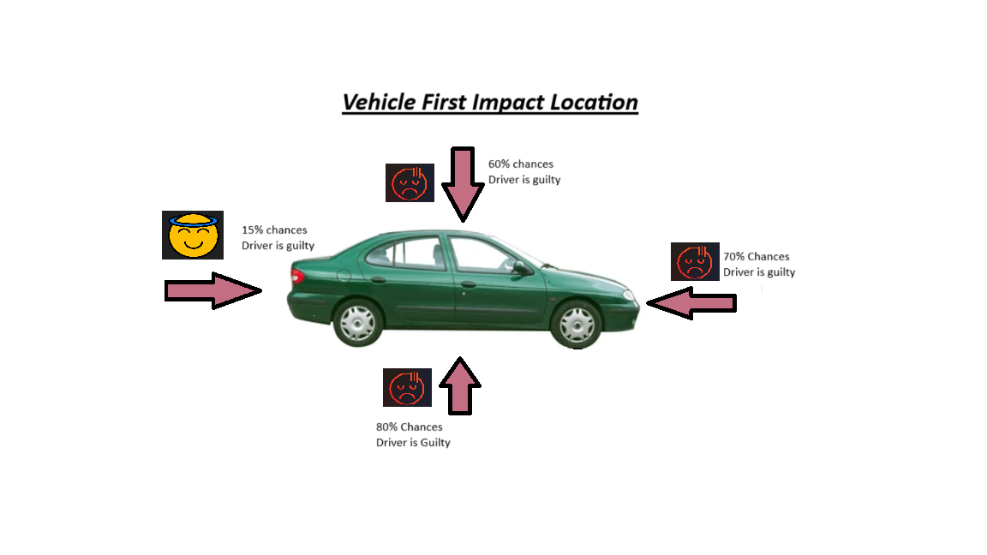
More than 70% of cases in which impact of first collision was rear side, underside or rooftop of the vehicle Driver was held responsible

Slide 6
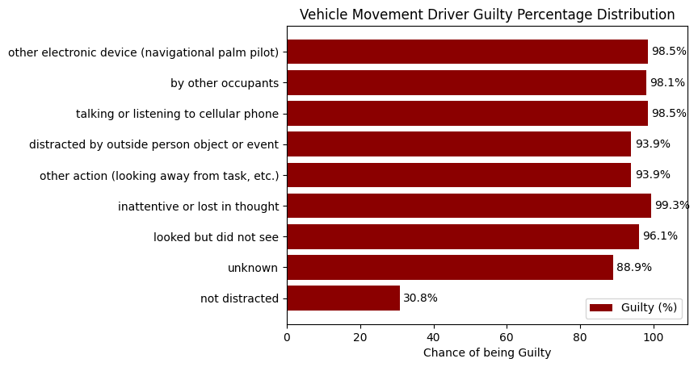
Drivers distracted by activities such as smoking, being inattentive or lost in thought, using a cellular phone (talking, texting, dialing), adjusting audio or climate controls, eating or drinking, or operating other electronic devices like navigation systems are held responsible for accidents in over 90% of cases

Slide 7
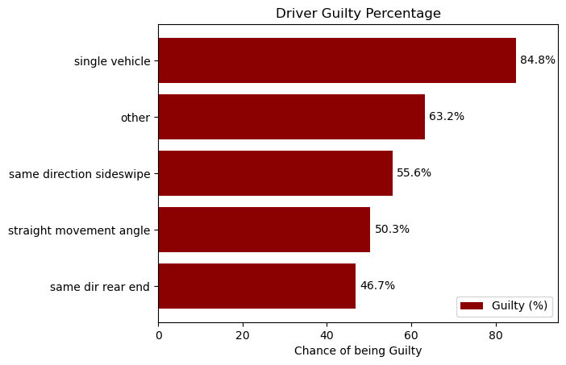
80% of cases in which only single vehicle was involved in collision - the driver was held responsible

Slide 8
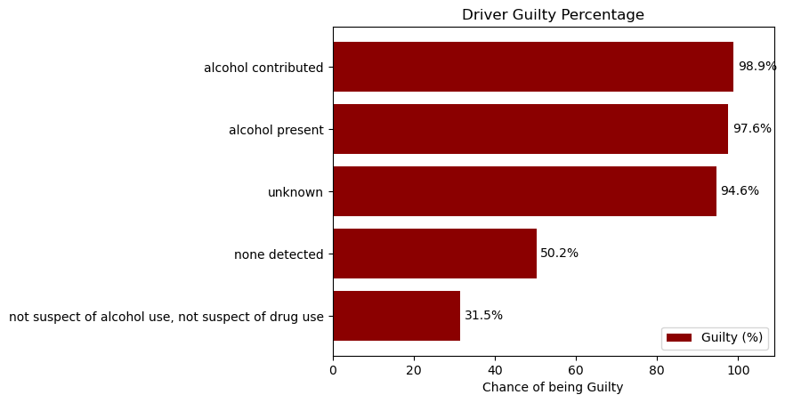
90% of cases in which there was surety that the driver has consumed alcohol or has any kind of involvement with drugs driver was held responsible

Slide 9
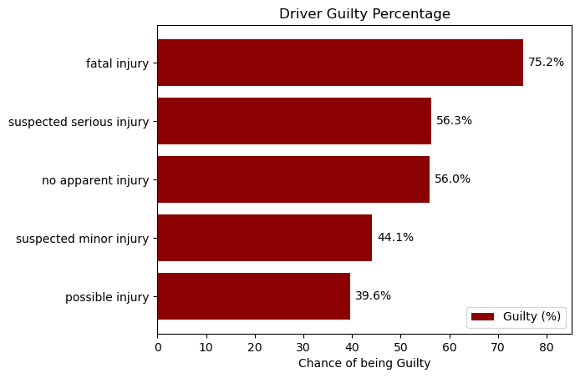
In 75% cases involving fatal Injury, driver was held responsible

Slide 10
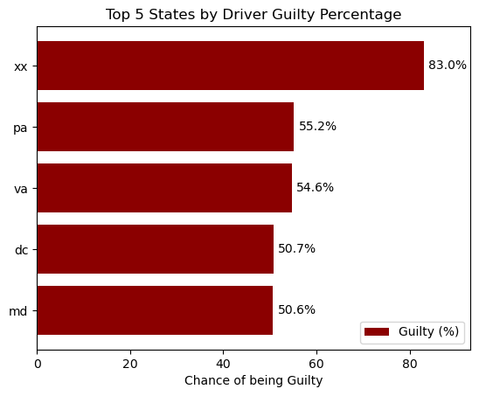
In 83% cases where driver did not have a valid driver’s license, driver was held responsible

Slide 11
The following conditions decreases the likelihood of the driver being held responsible for accidents:

Slide 12
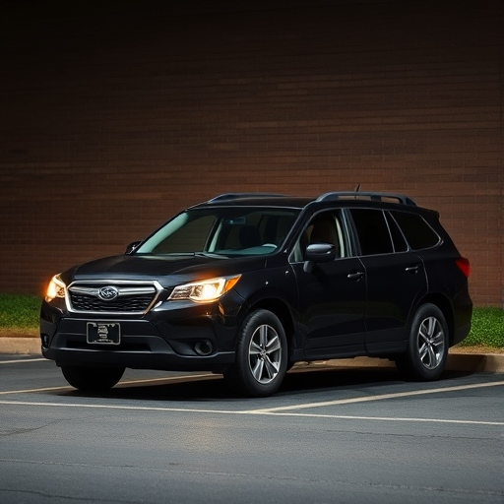

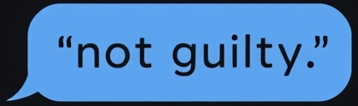
In 93% of cases, the driver was not held responsible when the vehicle was already parked.

